Slide 1
SreeKethana Gunuru -11591728
Anirudh Muppidi-11606127
Sahithi Singireddy - 11591749
Sai Shruthi Thileti- 11592257
Group-2
INFO 5082

Slide 2
A Machine Learning Model for Early Depression Detection

Slide 3
Agenda
Title
Motivation
Background
Abstract(Problem statement)
Literature Survey
Objectives of the Study
Data Set and Data Processing
Research Design(Blueprint/Workflow)
Data Analysis and Model Description
Data Visualization and Results
Conclusion
References

Slide 4
Introduction
Our Project, ‘A Machine Learning Model for Early Depression Detection’, uses early depression keywords from a Gemini AI API to perform sentimental analysis on Kaggle twitter dataset using Logistic Regression and CNN.
This facilitates to predict the depression at early stages and helps to takes necessary precautions.

Slide 5
Motivation
Nowadays many people are affecting with depression, which is a serious mental health condition.
This has a big impact on person’s life, which may lead to a thought of suicide.
We are using a social media platform i.e., twitter to get the people’s emotions.

Slide 6
Background
Social media platforms such as twitter are valuable resources of data for understanding and detecting mental health conditions of people.
We used a dataset containing tweets and extracted keywords to perform sentimental analysis.

Slide 7
Abstract (Problem Statement)
Traditional methods of depression screening depends on personal assessments, which is a time-consuming process.
Also, many people do not like to exhibit obvious symptoms, which is hard to identify their conditions.
Using twitter sentimental analysis helps to address these problems at the early stages of depression.

Slide 8
Literature Survey
The article “Depression detection using emotional artificial intelligence and machine learning: A closer review” aims to give an overview of the several AI and ML methods that aid in the detection and analysis of emotion, and thus depression, as well as the research questions that are associated with them
The article “Depression detection from social network data using machine learning techniques” aims to perform depression analysis on Facebook data collected from an online public source. To investigate the effect of depression detection, we propose machine learning techniques as an efficient and scalable method

Slide 9
Objectives of the study
Detect tweets containing signs of earlier depression
Develop a model to perform sentiment analysis on the twitter data
Evaluate model’s performance in terms of accuracy

Slide 10
Dataset and Data processing
Dataset is collected from Kaggle tweets data with 1.6 million tweets
We have used Gemini AI API to fetch earlier depression keywords as a prompt – “Early depression keywords count of 100 unique”
After getting depression keywords, we have done preprocessing to remove html tags, URLs, changed text to lowercase, and removed punctuations, stop words, white spaces, special characters

Slide 11
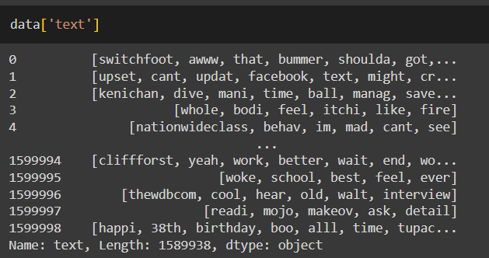
Dataset and Data processing
Performed tokenization, stemming and lemmatization for the tweets
After preprocessing, We got the result as

Slide 12
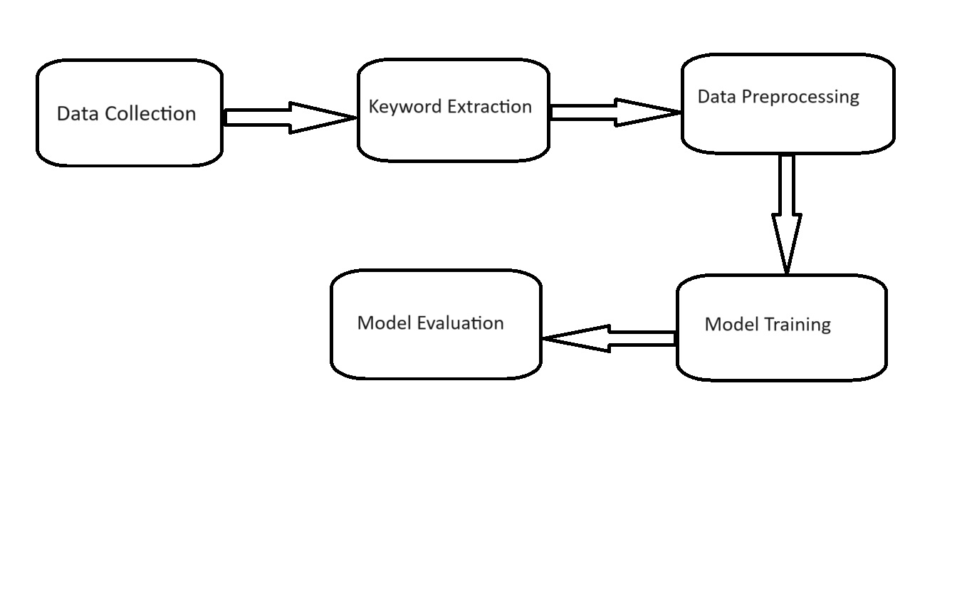
Research Design

Slide 13
Data Analysis and Model Description
Developed machine learning algorithms like CNN and Logistic Regression to assess model performance.
1.Convolutional Neural Networks(CNN):
CNN processes text data as a sequence of word embeddings.
The CNN architecture consists of convolutional layers that perform feature extraction across the text data.
This hierarchical feature extraction process allows the model to identify important patterns related to early depression keywords, enabling effective classification.

Slide 14
Data Analysis and Model Description
2.Logistic Regression:
After text data has been tokenized, Count Vectorizer is used to transform it into Bag-of-Words (BoW) features, which use word frequencies to quantitatively represent each document.
After initializing and training on this BoW representation, a Logistic Regression model is used to determine the connection between the target variable denotes the existence of depression and the extracted features.
The trained model then predicts whether depression will be present on the testing set. To assess the model's effectiveness in early depression detection, performance metrics like accuracy, precision, recall, F1 score, and ROC AUC score are calculated.

Slide 15
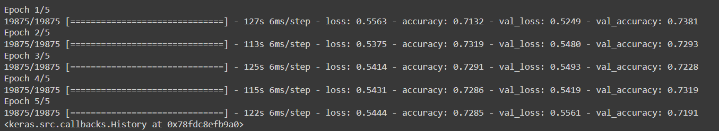
Results
For CNN

Slide 16
Results
For logistic regression
accuracy - 0.7779821880070946
Precision - 0.766625685927614
Recall - 0.8013678878607788
F1 - 0.7836118935453518

Slide 17
Conclusion
The findings of this study have the potential to help increase mental health monitoring and detection utilizing social media data.
In addition to development in data science and mental health, the project demonstrates the use of social media in improving mental health monitoring and detection.

Slide 18
References
Raymond Chiong, Gregorius Satia Budhi, Sandeep Dhakal, and Fabian Chiong. A textual-based featuring approach for depression detection using machine learning classifiers and social media texts. Computers in Biology and Medicine, 135:104499, 2021.
Md Rafiqul Islam, Muhammad Ashad Kabir, Ashir Ahmed, Abu Raihan M Kamal, Hua Wang, and Anwaar Ulhaq. Depression detection from social network data using machine learning techniques. Health information science and systems, 6:1–12, 2018.
Chenhao Lin, Pengwei Hu, Hui Su, Shaochun Li, Jing Mei, Jie Zhou, and Henry Leung. Sensemood: depression detection on social media. In Proceedings of the 2020 international conference on multimedia retrieval, pages 407–411, 2020.

Slide 19
Thank You

